Slide 1

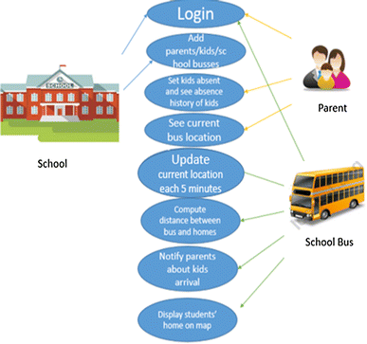
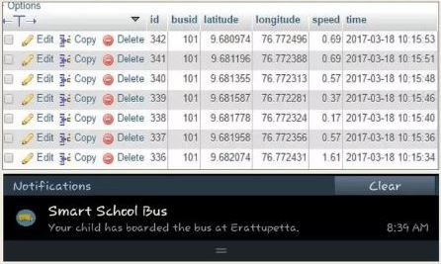
Bus Tracking System Using GPS
Department of Computer Science and Engineering
Global Campus, Jakkasandra Post, Kanakapura Taluk, Ramanagara District, Pin Code: 562 112
Abstract
The project aims to develop a low cost vehide tracking system that wil ensure the safe commute Of children. It involves Internet Of
Things application that tracks the geographic location of school buses in real time and it on a map in a mobile app. The application gives information about
the bus, speed and designated routeIt is aimed at a user base Which incudes the faculties, bus drivers anparents. It is expected to solve the
problem of students missing the bw and ensure the safe pick up and dro off of students by providing the tracking facility at affordable costs.
Introduction
Ues Case Diagram
The commute Of students from home to school
and back has always been a source of concern for
parents. Students often get on the wrong buses
and get off at the wrong stops. gus drivers maybe
unable to identify all students and will not know
in time if a Student is missing. Parents have n0
way of knowing if their ward is safe until the
evening when the bus returns.
While some schools have already implemented
GPS tracking of buses using GSM, that do not give
real time updation or individual information Of
students. Raspberry Pi systems have been known
to give real time information but the cost is too
high for it to be a replacement for GSM systems.
This project on implementation, will be a means
to monitor school buses comprehensively
including the speed, the people
adherence to route, time etc.
Methods And Materials
Resalt
The components used for the tracker are ESP8266
microcontroller which has a built-in WiFi module,
Ublox 6M GPS module and a MFRC522 RFID
Reader. The microcontroller constantly uploads
the lcxation input by the GPS module to a mysql
database hosted on an Apache server. A front-end
android application downloads the data from the
database and plots the location on a map in real
time using Google Maps API for Android.
The id cards of students are embedded with an
RFID tag. The RFID reader in the tracker which is
positioned at the entrance of the bus will
automatically identify each student as they
board/alight. The microcontroller will then invoke
a PHP script which will send a push notification
using Firebase Cloud Messaging (FCM) to the
respective parents' mobile app, notifying them Of
the drop off/boarding location and time.
Figures below show the outputs like database trace and app screenshots. The first figure shows the database trace Of the lccation upload. The second figure Shows a push notification informing a parent of his kid's safe boarding. The third figure shows the traversed route and current location plotted on the map.
Conclusion
References
The aim was to develop a low cost tracking system. The ESP costs 53 when Arduino Costs $6 and Raspberry pie $25. The entire system cost less than IJSD20 when Arduino •GSM systems cost USDI and Raspberry Pi systems cost USD 20 Rasptrrry pi systems have been known to show packet loss
rates as low as 0-0.50%. Packet IOSS rates Of ESP8& are Close to that Of Arduino at 1-2%.
[1]. Chen, H., Chiang, Y. Chang, F., H. Wang, H. (2010). Toward Real-Time Precise Point Positioning: Differential GPS Based on IGS Ultra Rapid Product,SICE Annual Conference, The Grand Hotel, Taipei, Taiwan August 18-21.
[2]. Asaad M. J. Al-Hindawi, Ibraheem Talib, “Experimentally Evaluation of GPS/GSM Based System Design”, Journal of Electronic Systems Volume 2 Number 2 June 2012
[3]. Chen Peijiang, Jiang Xuehua, “Design and Implementation of Remote monitoring system based on GSM,” vol.42, pp.167-175. 2008.
[4]. V.Ramya, B. Palaniappan, K. Karthick, “Embedded Controller for Vehicle In-Front Obstacle Detection and Cabin Safety Alert System”, International Journal of
Computer Science & Information Technology (IJCSIT) Vol 4, No 2, April 2012.
DrawBacks
The range of the RFID reader is as low as •cm and hence
impractical for commercial purposes.
The http connection is not encrypted and hence easily
susceptible to hacking.
The project assumes WiFi to ubiquitous without which, the
system will fail.
There is an initial delay of almost Iminute for the GPS module to
Startup on power up.

